Slide 1
CS273B: Deep learning for Genomics and Biomedicine
Lecture 3: Convolutional neural networks for genomics and imaging data
10/03/2016
Anshul Kundaje, James Zou, Serafim Batzoglou

Slide 2
Administration stuff
Start forming project teams! (5-6 students)
Smaller teams are allowed if you have your own compute.
If you need help finding team members, message on Piazza and message the TAs.
Teams must be finalized by next Wednesday
We will release suggested project topics and descriptions by weekend. You are free to pick your own projects.
We will poll teams for preferences for paper presentations and try to accommodate requests as much as possible.
If you are auditing the course and want to get added to Canvas, meet TAs after class.

Slide 3
Outline
Multi-modal convolutional neural networks for predicting protein-DNA binding maps
Convolutional neural networks on images

Slide 4
Convolutional neural networks for learning from DNA sequence

Slide 5
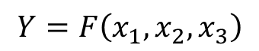
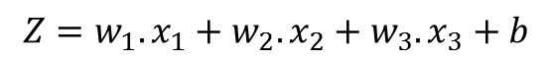
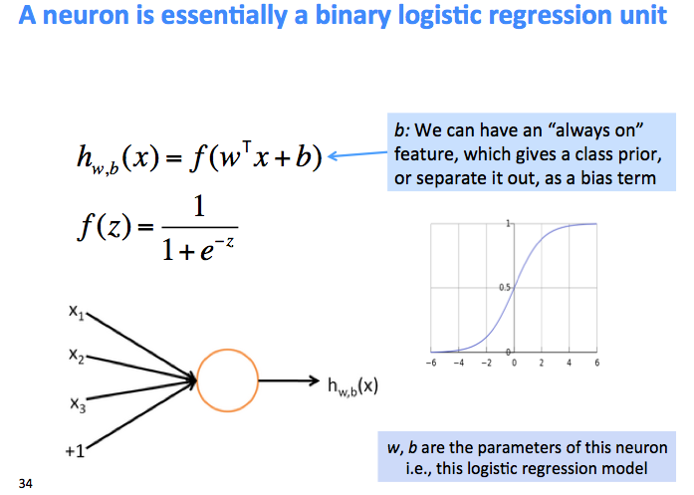
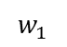
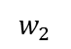
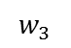
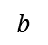
A simple classifier
(An artificial neuron)
parameters
Linear function
Z
Training the neuron means learning the optimal w’s and b

Slide 6
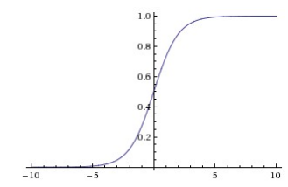
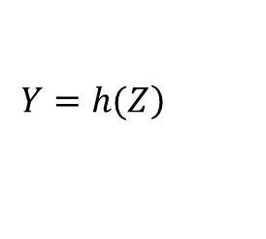
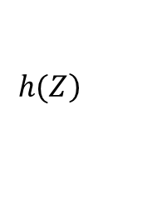
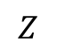
A simple classifier
(An artificial neuron)
Logistic / Sigmoid
Useful for predicting probabilities
parameters
Non-linear function
Y
0
Training the neuron means learning the optimal w’s and b

Slide 7
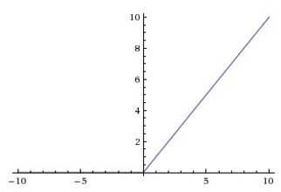
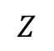
A simple classifier
(An artificial neuron)
ReLu (Rectified Linear Unit)
Useful for thresholding
parameters
Non-linear function
Y
Training the neuron means learning the optimal w’s and b

Slide 8
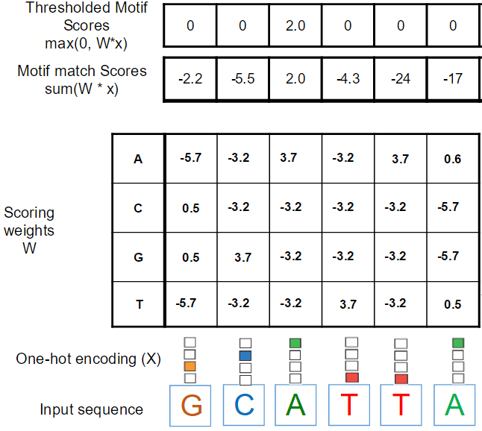
Artificial neuron can represent a motif
parameters
-2.2 | -5.4 | 2.0 | -4.3 | -24 | -17
Y

Slide 9
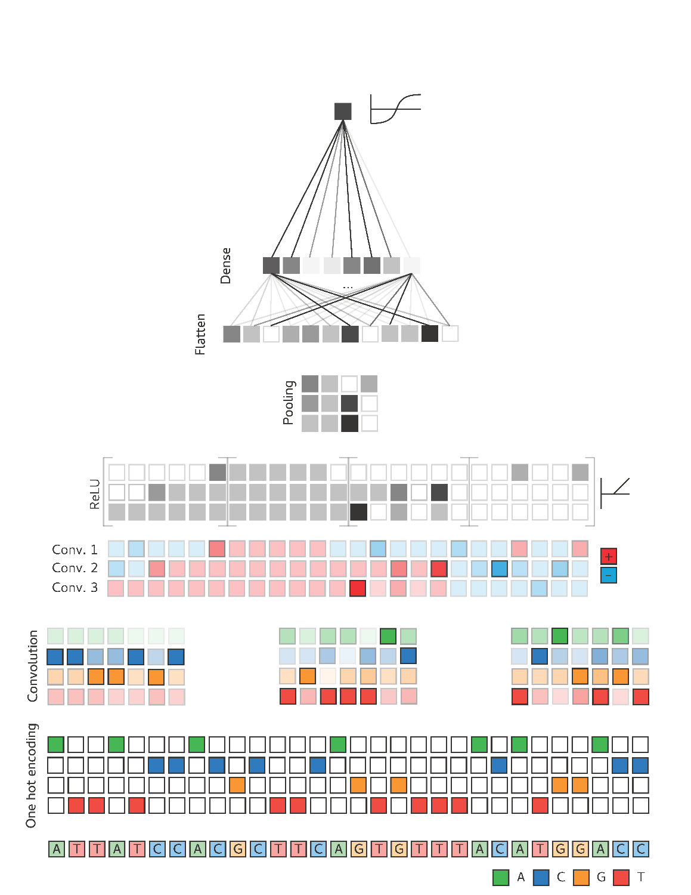
Multi-task CNN
P (TF1 = bound | X)
P (TF2 = bound | X)
Multi-task output
(sigmoid activations here)
Typically followed by one or more fully connected layers
Maxpooling layer
pool width = 2
stride = 1
Maxpooling layers take the max over sets of conv layer outputs
Max = 6
Max = 2
max
max
Conv Layer 2
Kernel width = 3
stride = 1
num filters / num channels = 2
total neurons = 6
Later conv layers operate on outputs of previous conv layers
1
2
6
Convolutional layer
(same color = shared weights)
Conv Layer 1
Kernel width = 4
stride = 2*
num filters / num channels = 3
Total neurons = 15
G
C
A
T
T
A
C
C
G
A
T
A
A

Slide 10
Multi-modal convolutional neural networks for predicting protein-DNA binding

Slide 11
Learning patterns in regulatory DNA sequence
Positive class of genomic sequences bound a transcription factor of interest
Negative class of genomic sequences not bound by a transcription factor of interest
TF
Can we learn patterns in the DNA sequence that distinguish these 2 classes of genomic sequences?
TF

Slide 12
Predicting binding in new cell types
Sequence is static across cell types.
A sequence only model cannot generate cell-type specific binding predictions with no other input.
We need an some other type of input data type that provides some information about cell-type specific use of DNA sequence

Slide 13
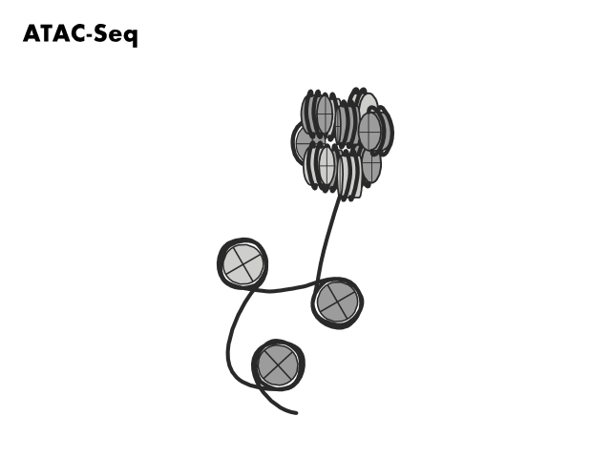
Chromatin accessibility
Greenleaf lab
Notes:
[Spend more time]
To overcome these limitations,
Our collaborators in the Greenleaf lab recently developed an assay for open chromatin, ATAC-seq, that is able to work with low input material. The way ATAC-seq works is ….
Explain protocol – Tn5
Paired end sequencing (impt)
Gives genome wide accessibility, find peaks
Show genome browser track with the signal
Identify control elements

Slide 14
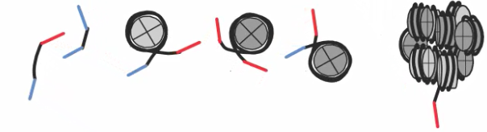
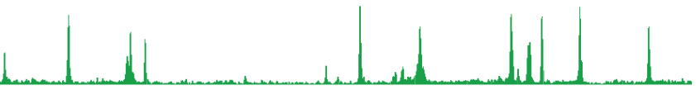
Read both ends and
map to genome
ATAC-seq peaks identify accessible control elements
Buenrostro et al. (2013) Nature Methods.
Notes:
ATACseq -> data track
Peaks consist of regions of the genome that are very accessible and cut many times.
These peaks also correspond to control elements.
But the fact that we used paired end sequencing gives us more information than just the cut sites. We also get the lengths of the fragments

Slide 15
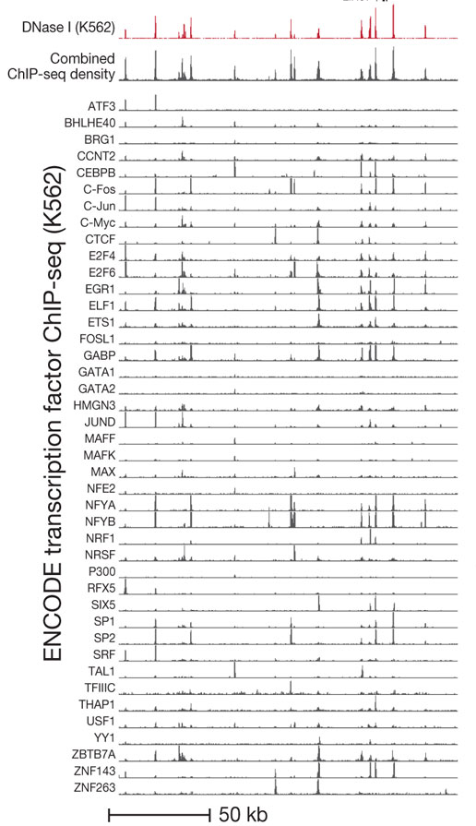
Chromatin accessibility ~= sum (ChIP-seq for all DNA binding proteins)
Peaks of chromatin accessibility signal at specific genomic locations tells us “something binds there”
BUT we don’t know who binds there.
Sequence patterns could tell us who binds there!
Integrate sequence + chromatin accessibility patterns to predict TF binding events (from ChIP-seq data)!

Slide 16
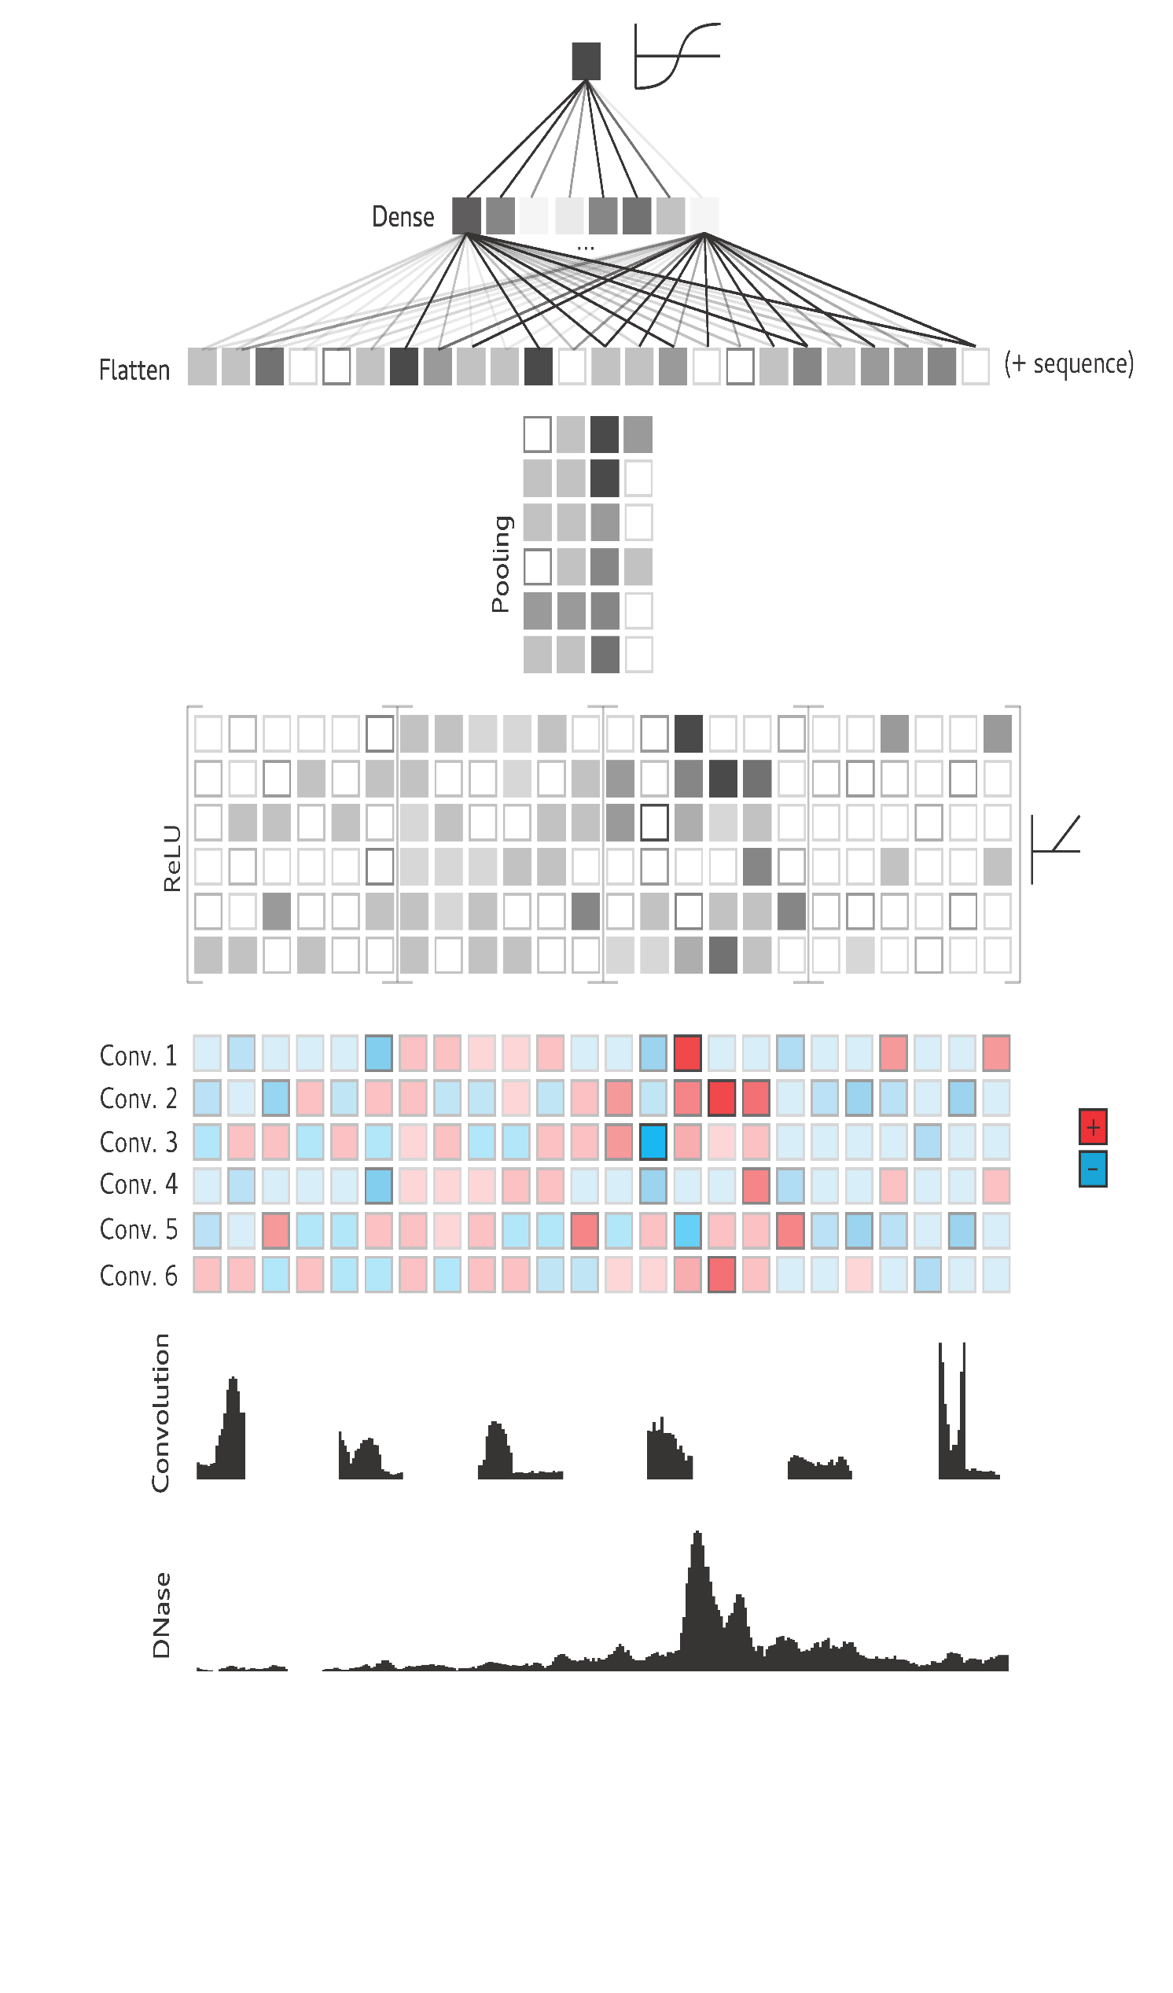
CNN filters for learning patterns from chromatin accessibility data
Scan chromatin accessibility profile using filter
Notes:
Can we decompose the effects into the accessibility vs nucleosome positioning?

Slide 17
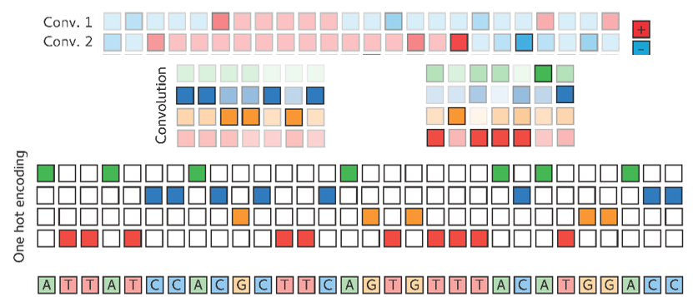
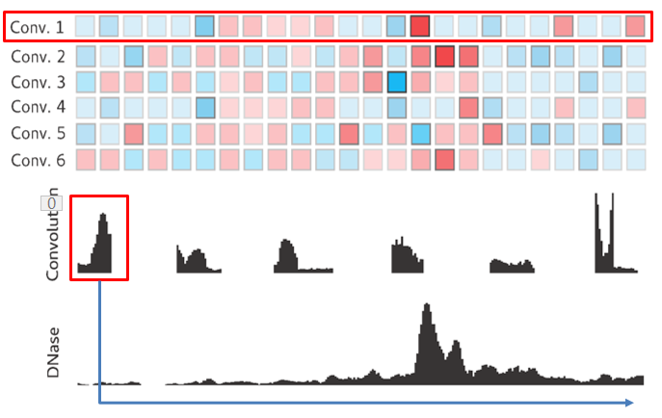
Multi-modal integrative model
TF4
TF5
TF6
TF3
TF7
Multi-task learning
TF2
TF8
TF1
Class Probabiliies
2nd FC Layer
1st FC Layer
2nd set of Convolutional Maps
Multi-modal input
1.5 Kbp 1D DNase-seq profile
1.5 Kbp raw DNA sequence
Notes:
Explain that we are not just predicting the RHS states, but also the LHS marks

Slide 18
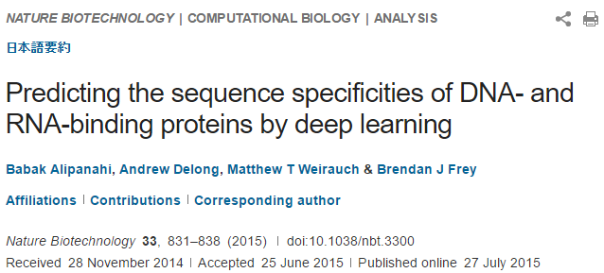
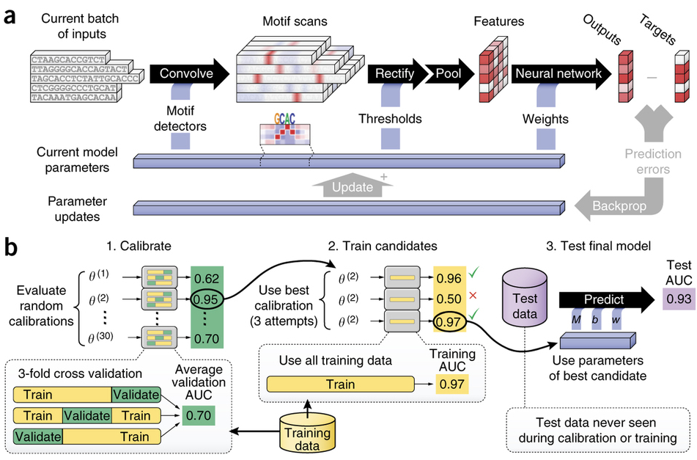
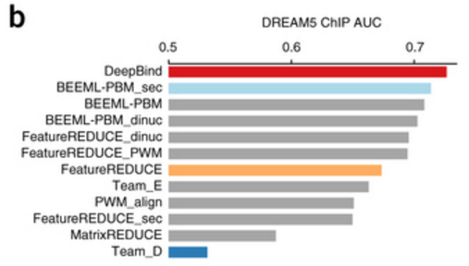
http://www.nature.com/nbt/journal/v33/n8/full/nbt.3300.html

Slide 19
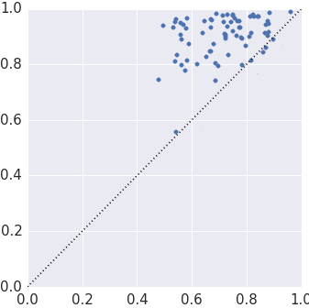
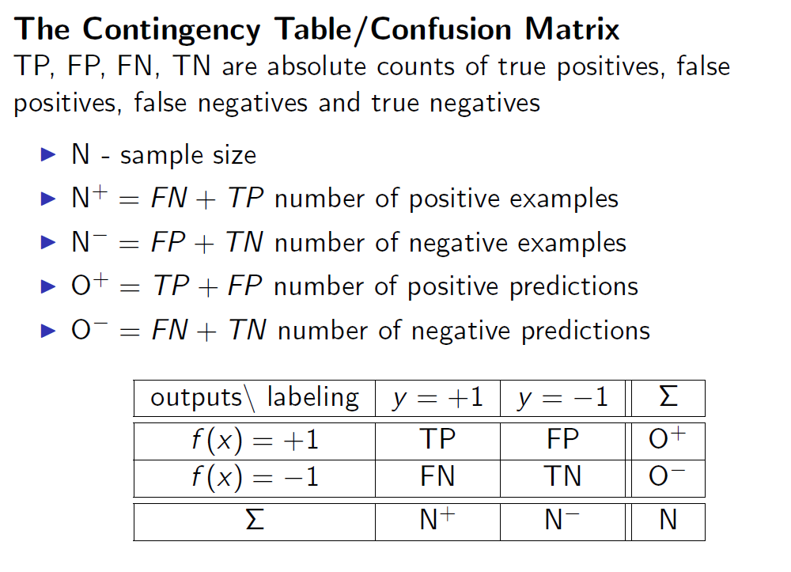
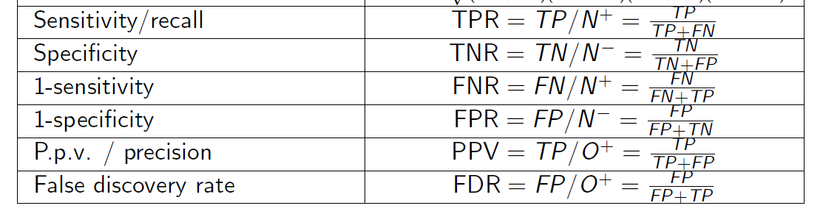
Performance evaluation
auROCs look great!
Hurray! Looks like we don’t need ChIP-seq data any more!
Area under Receiver Operating Curve (auROC)
40 diverse TFs
Integrative Deep CNN
DeepBind
(Alipanahi et al. 2015)
Notes:
(Recall) True Positive Rate vs. (Precision) 1- False Discovery Rate

Slide 20
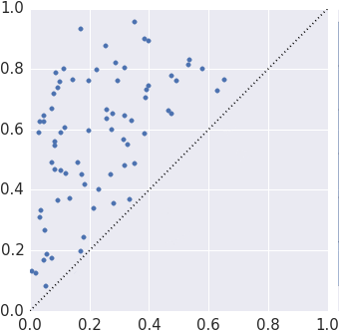
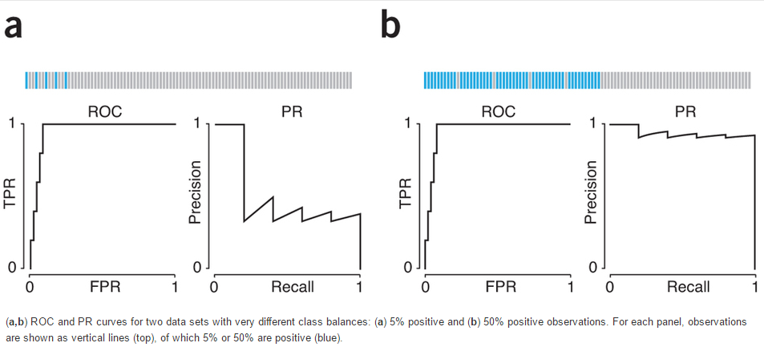
Performance evaluation metric matters!
Area under Precision-Recall Curve
Prediction task is highly unbalanced (50-100x more negatives than positives)
auROC is highly misleading for unbalanced data!
40 diverse TFs
Integrative Deep CNN
DeepBind
(Alipanahi et al. 2015)
http://www.nature.com/nmeth/journal/v13/n8/full/nmeth.3945.html
FYI: auPRC implementation in scikit-learn is wrong!
Notes:
(Recall) True Positive Rate vs. (Precision) 1- False Discovery Rate

Slide 21
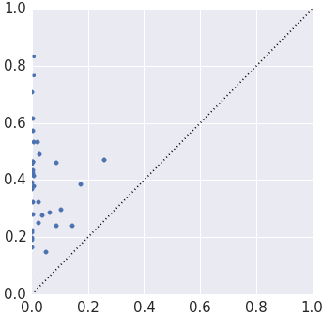
Negative set matters!
Recall at 10% FDR (90% precision)
Why does DeepBind do so poorly in this setting?
Trains on dinucleotide shuffled negatives (not representative of relevant genomic background)
Negative set matters!
Integrative Deep CNN
DeepBind

Slide 22
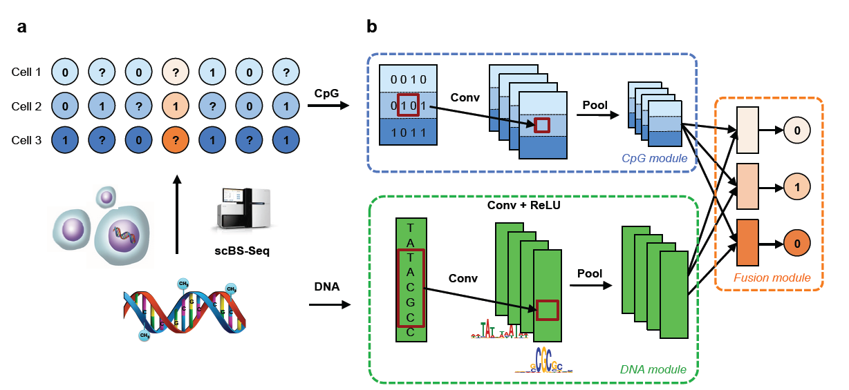
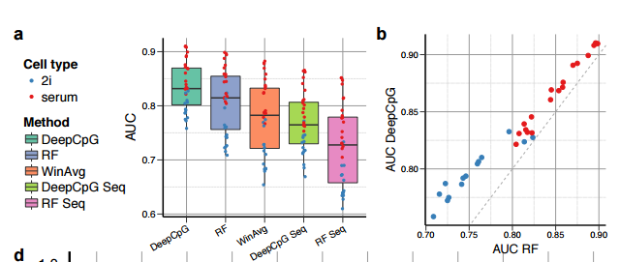
http://biorxiv.org/content/early/2016/05/27/055715

Slide 23
Convolutional neural networks for learning from imaging data
(Slides taken from Andrej Karpathy’s CS231N lectures)

Slide 24
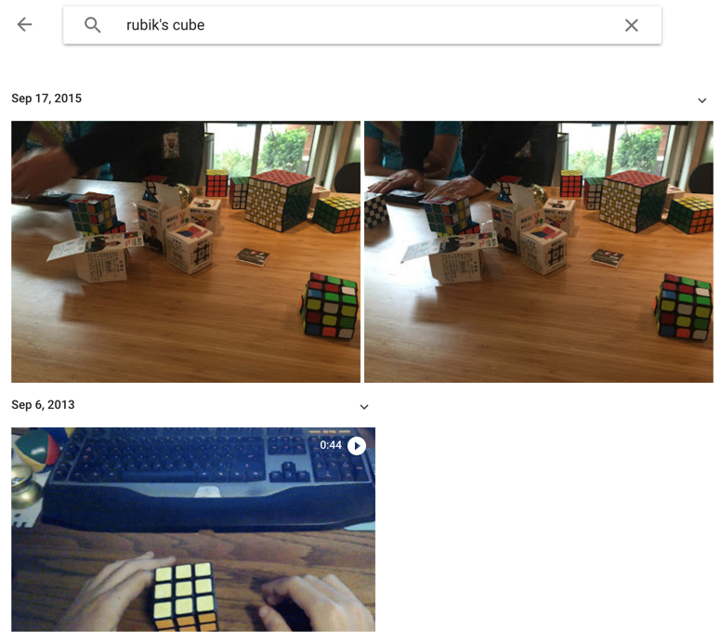
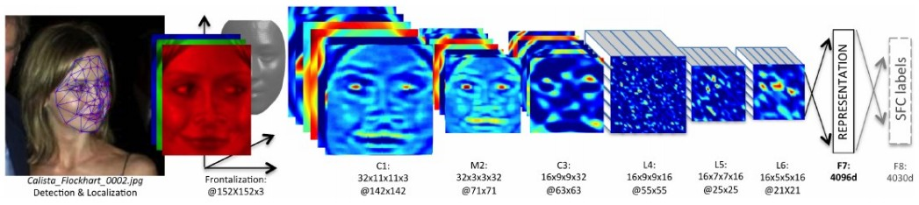
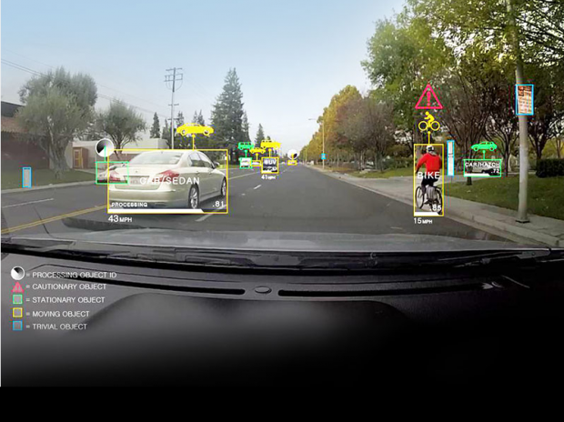
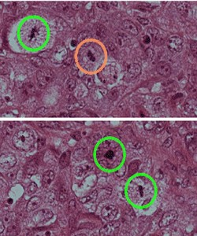
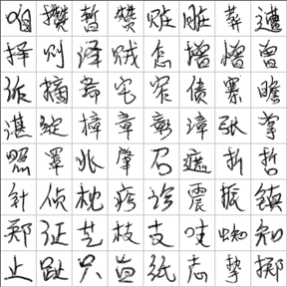
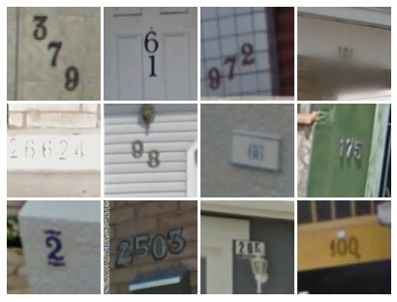
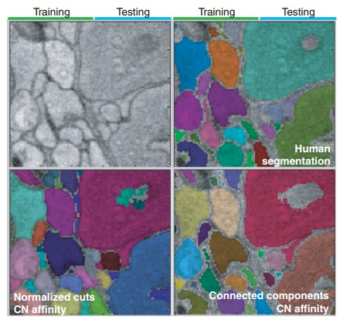
ConvNets are everywhere…
Face Verification, Taigman et al. 2014 (FAIR)
e.g. Google Photos search
Ciresan et al. 2013
[Goodfellow et al. 2014]
Self-driving cars
Turaga et al 2010

Slide 25


Slide 26
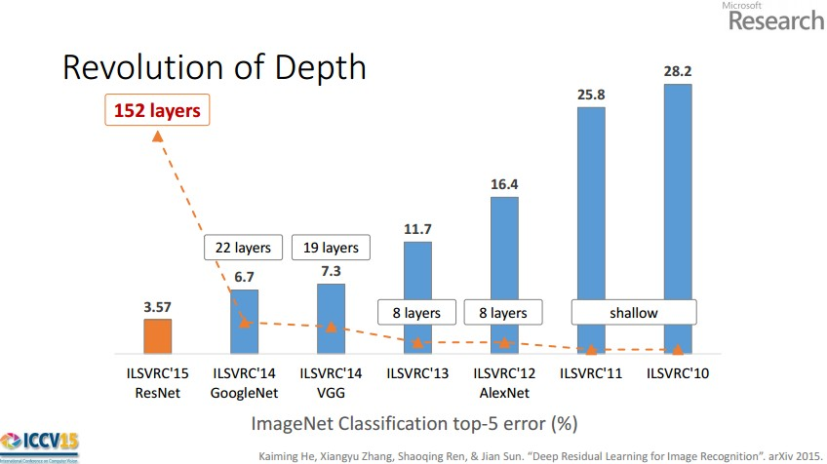
(slide from Kaiming He’s recent presentation)

Slide 27
Convolution Layer
32x32x3 image
32
height
32
width
3
depth

Slide 28
Convolution Layer
32x32x3 image
5x5x3 filter
32
Convolve the filter with the image
i.e. “slide over the image spatially, computing dot products”
32
3

Slide 29
Convolution Layer
Filters always extend the full depth of the input volume
32x32x3 image
5x5x3 filter
32
Convolve the filter with the image
i.e. “slide over the image spatially, computing dot products”
32
3

Slide 30

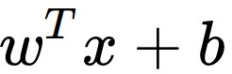
Convolution Layer
32x32x3 image
5x5x3 filter
32
1 number:
the result of taking a dot product between the filter and a small 5x5x3 chunk of the image
(i.e. 5*5*3 = 75-dimensional dot product + bias)
32
3

Slide 31
Convolution Layer
activation map
32x32x3 image
5x5x3 filter
32
28
convolve (slide) over all spatial locations
32
28
3
1

Slide 32
consider a second, green filter
Convolution Layer
32x32x3 image
5x5x3 filter
activation maps
32
28
convolve (slide) over all spatial locations
32
28
3
1

Slide 33
For example, if we had 6 5x5 filters, we’ll get 6 separate activation maps:
activation maps
32
28
Convolution Layer
32
28
3
6
We stack these up to get a “new image” of size 28x28x6!

Slide 34
For example, if we had 6 5x5 filters, we’ll get 6 separate activation maps:
activation maps
32
28
Convolution Layer
32
28
3
6
We processed [32x32x3] volume into [28x28x6] volume.
Q: how many parameters would this be if we used a fully connected layer instead?

Slide 35
For example, if we had 6 5x5 filters, we’ll get 6 separate activation maps:
activation maps
32
28
Convolution Layer
32
28
3
6
We processed [32x32x3] volume into [28x28x6] volume.
Q: how many parameters would this be if we used a fully connected layer instead?
A: (32*32*3)*(28*28*6) = 14.5M parameters, ~14.5M multiplies

Slide 36
For example, if we had 6 5x5 filters, we’ll get 6 separate activation maps:
activation maps
32
28
Convolution Layer
32
28
3
6
We processed [32x32x3] volume into [28x28x6] volume.
Q: how many parameters are used instead?

Slide 37
For example, if we had 6 5x5 filters, we’ll get 6 separate activation maps:
activation maps
32
28
Convolution Layer
32
28
3
6
We processed [32x32x3] volume into [28x28x6] volume.
Q: how many parameters are used instead? --- And how many multiplies?
A: (5*5*3)*6 = 450 parameters

Slide 38
For example, if we had 6 5x5 filters, we’ll get 6 separate activation maps:
activation maps
32
28
Convolution Layer
32
28
3
6
We processed [32x32x3] volume into [28x28x6] volume.
Q: how many parameters are used instead?
A: (5*5*3)*6 = 450 parameters, (5*5*3)*(28*28*6) = ~350K multiplies

Slide 39

Pooling layer
makes the representations smaller and more manageable
operates over each activation map independently:

Slide 40
MAX POOLING
Single depth slice
1 | 1 | 2 | 4
5 | 6 | 7 | 8
3 | 2 | 1 | 0
1 | 2 | 3 | 4
x
max pool with 2x2 filters and stride 2
6 | 8
3 | 4
y

Slide 41
Fully Connected Layer (FC layer)
Contains neurons that connect to the entire input volume, as in ordinary Neural Networks

Slide 42
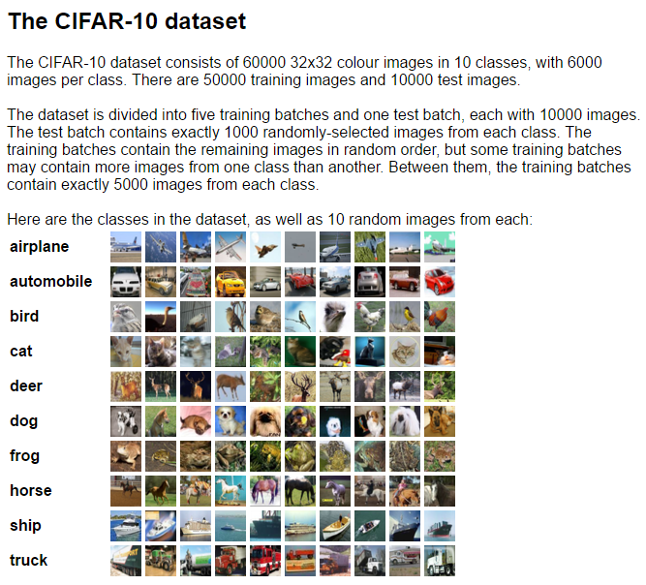
ConvNetJS demo: training on CIFAR-10
http://cs.stanford.edu/people/karpathy/convnetjs/demo/cifar10.html

Slide 43
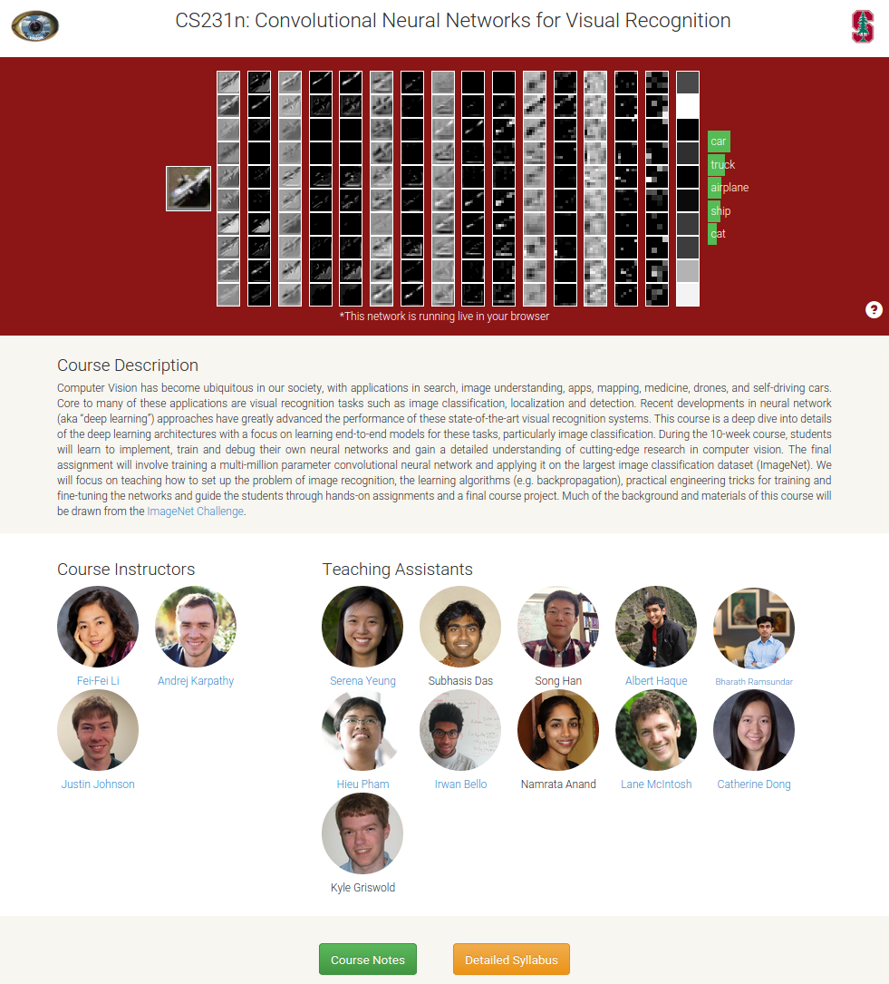
CNNs for vision/images CS231n
cs231n.stanford.edu
Specifically check out lecture 7
https://www.youtube.com/watch?v=AQirPKrAyDg
Read http://cs231n.github.io/convolutional-networks/

Slide 44
Additional optional readings

Slide 45
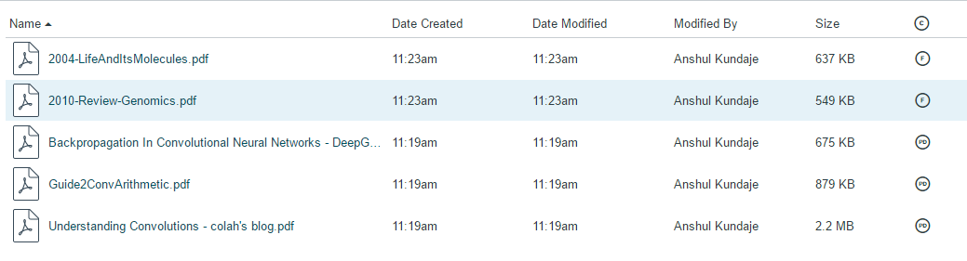
In Canvas
https://canvas.stanford.edu/courses/51037/files/folder/LectureMaterial/Lecture2

